Slide 1
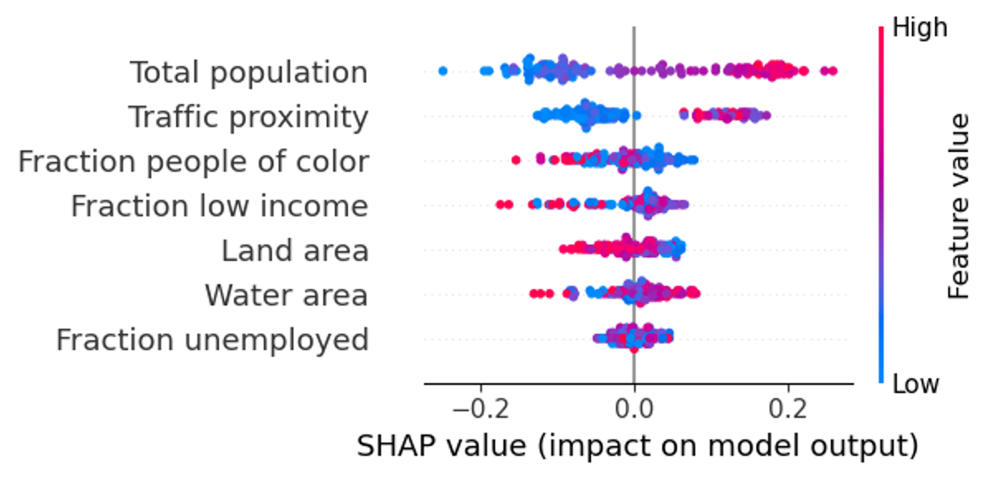
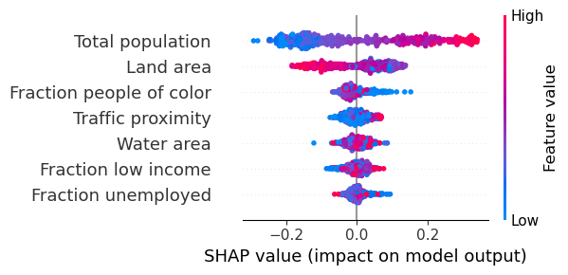
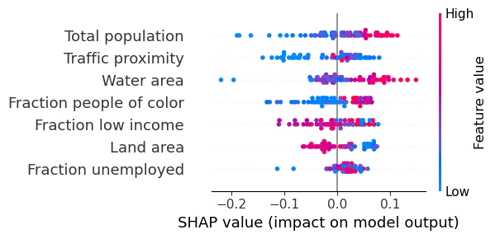
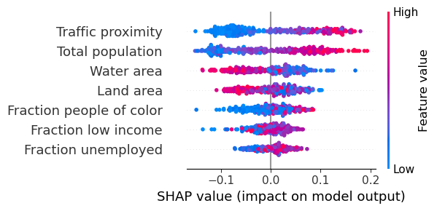
West (N=449, accuracy=0.719)
South (N=1500, accuracy=0.724)
Northeast (N=217, accuracy=0.712)
Midwest (N=1055, accuracy=0.666)

Slide 2
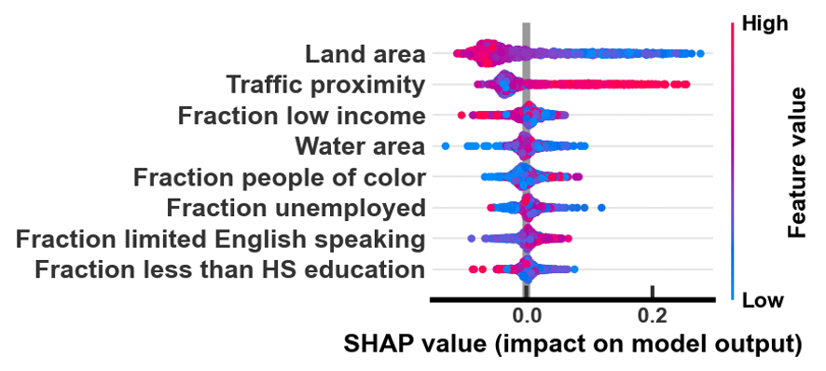
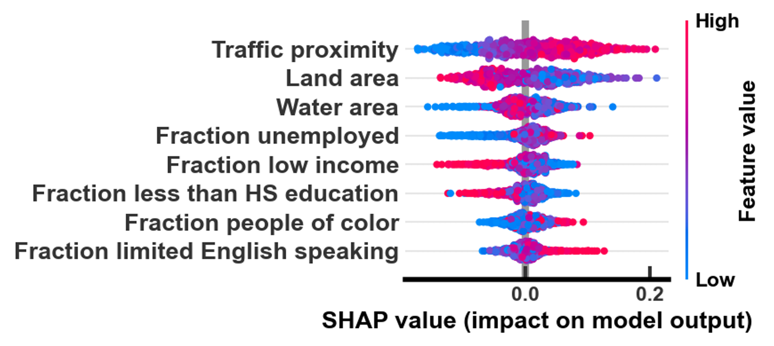
Operational (accuracy: 0.861)
Potential (accuracy: 0.649)

Slide 3
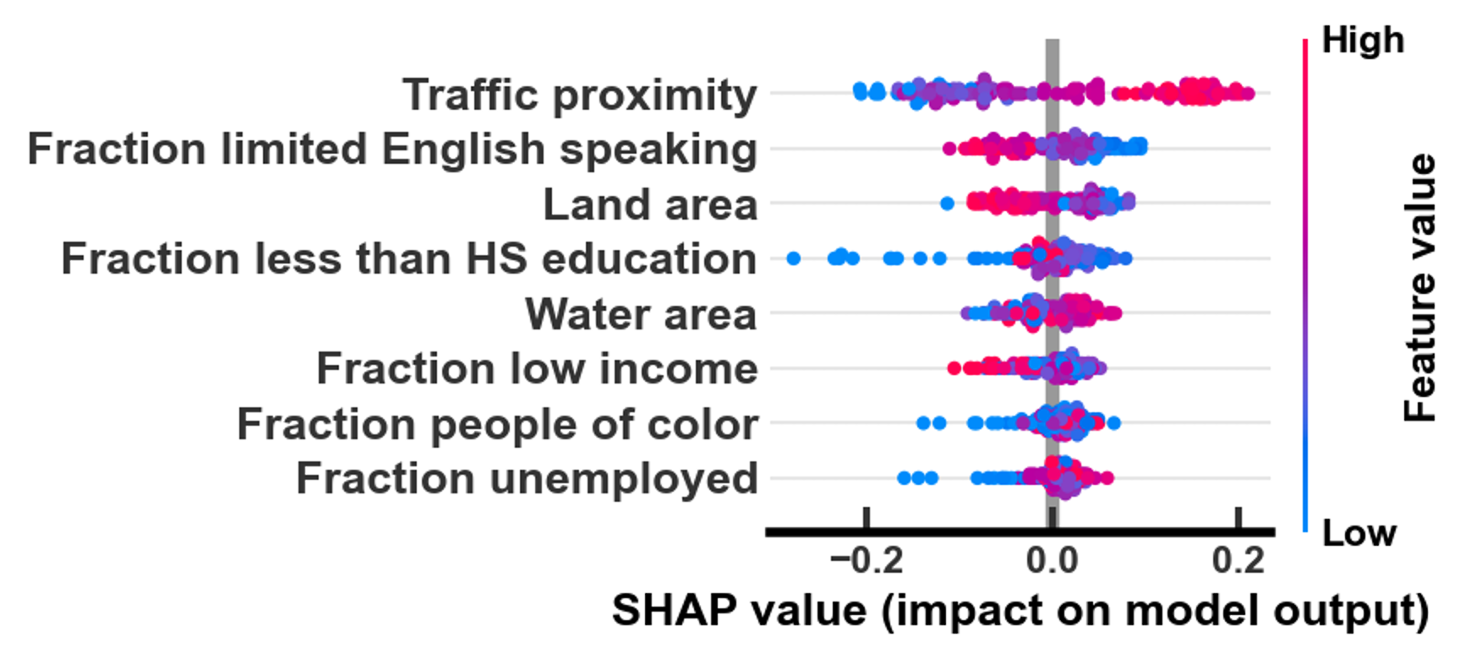
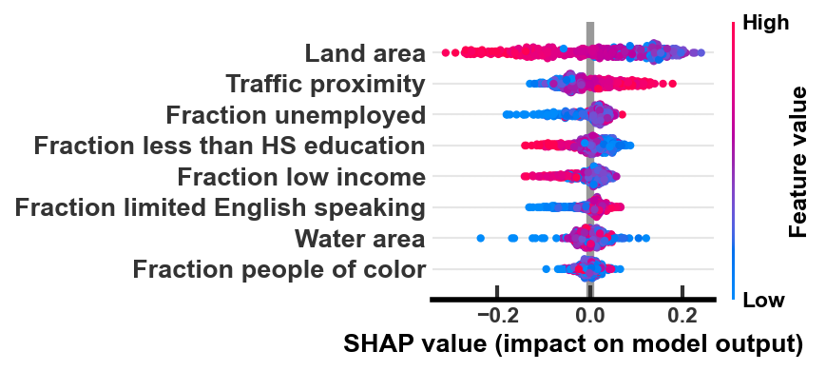
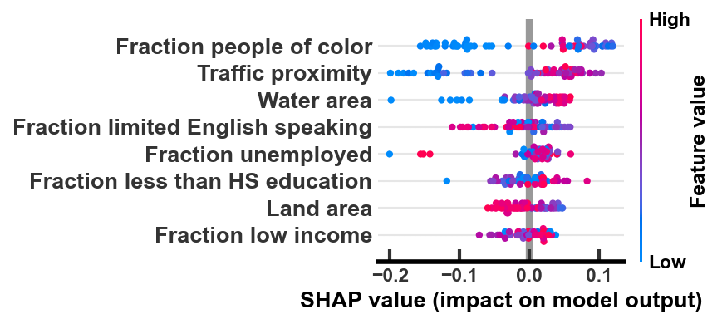
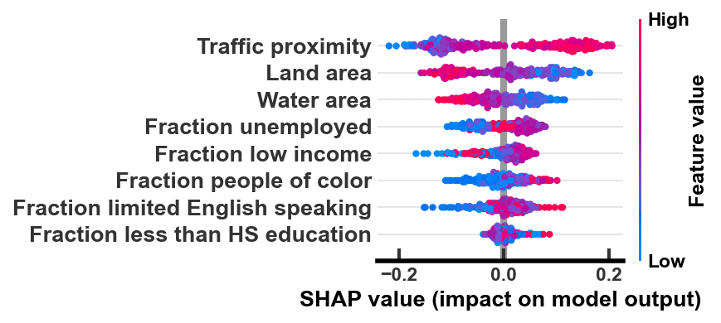
West (N=449)
South (N=1500)
Northeast (N=217)
Midwest (N=1055)

